Slide 1


CarShowRoom
Louaai Zailaei - 202311058
Thamer Almadi - 202311136
Amro Mohammed Elian - 202311430

Slide 2
About our website
Introduction to the Website
Pages of the website
Target Audience
Our website is a showroom for different kinds of cars that ranges in price and luxury.
Our website consists of a home page, about us, contact us, and a registration form.
Car enthusiasts seeking detailed information about new models, potential buyers looking for a new vehicle, and individuals interested in financing and leasing options.

Slide 3




Colors used
Hexadecimal Value | Color | Used For
#5d7c7e |  | Background
#333 |  | Header and Footer
#ffffff |  | Text and Boxes
#0096bf |  | Buttons

Slide 4
Page Hierarchy
Registration
Home page
About Us
Contact us

Slide 5
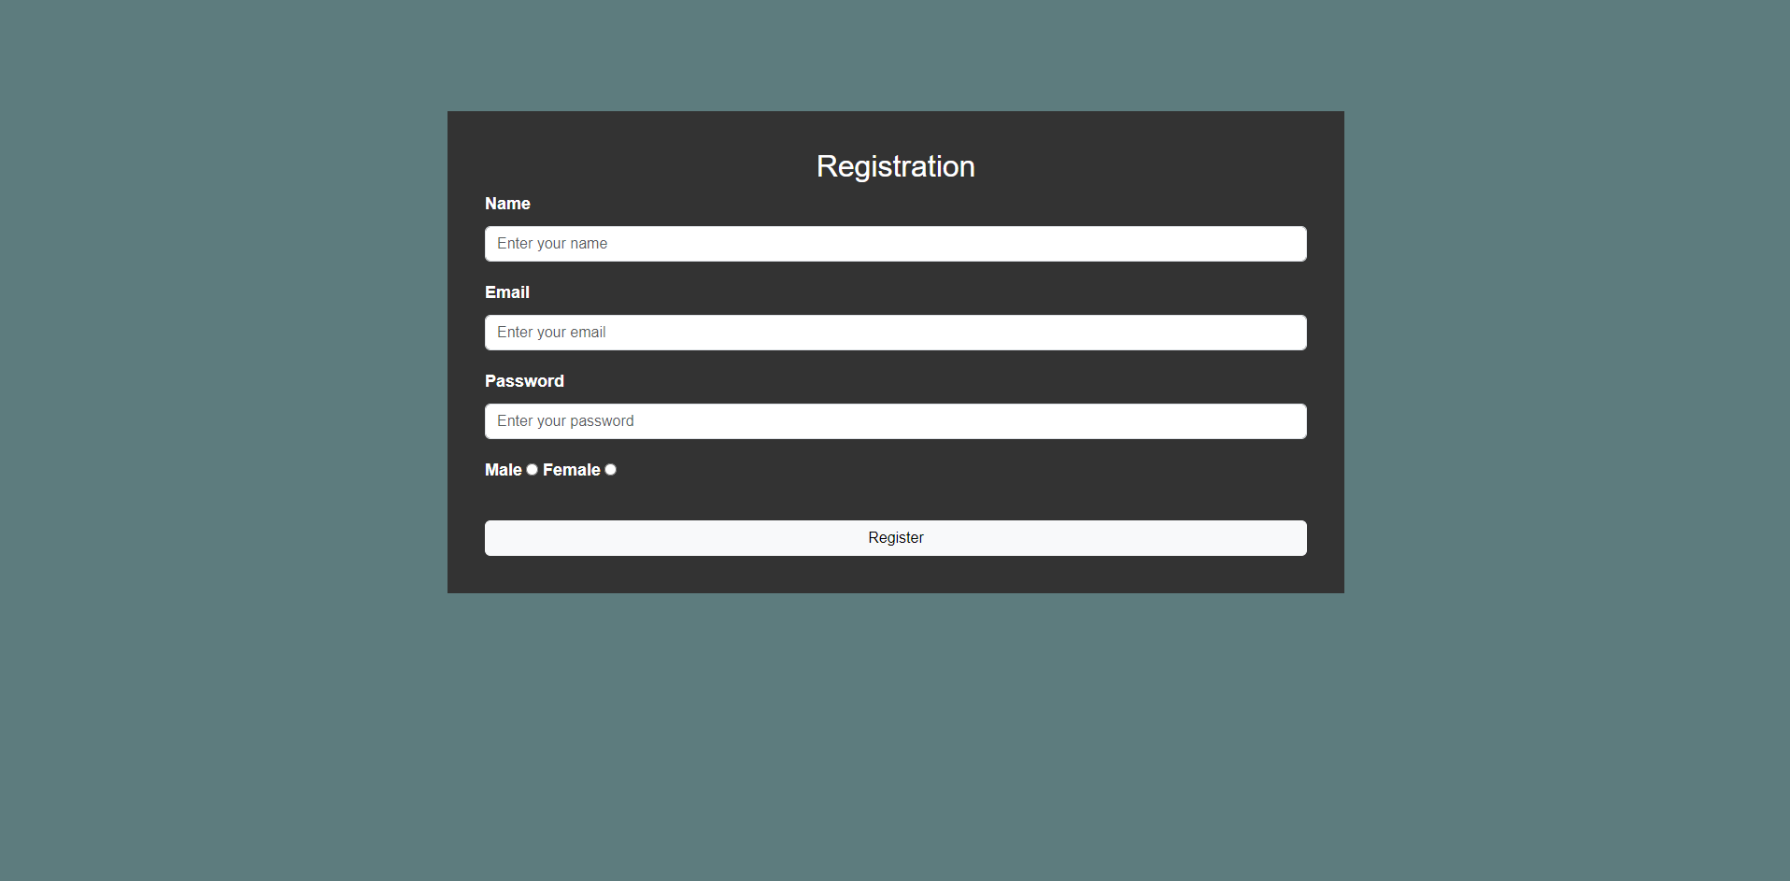
How does our website look?
Registration
registration is the signing in page for the website.
1
We used a container to coordinate the form.
2
The user will have access to the home page after completing the sign in proccess.
3

Slide 6
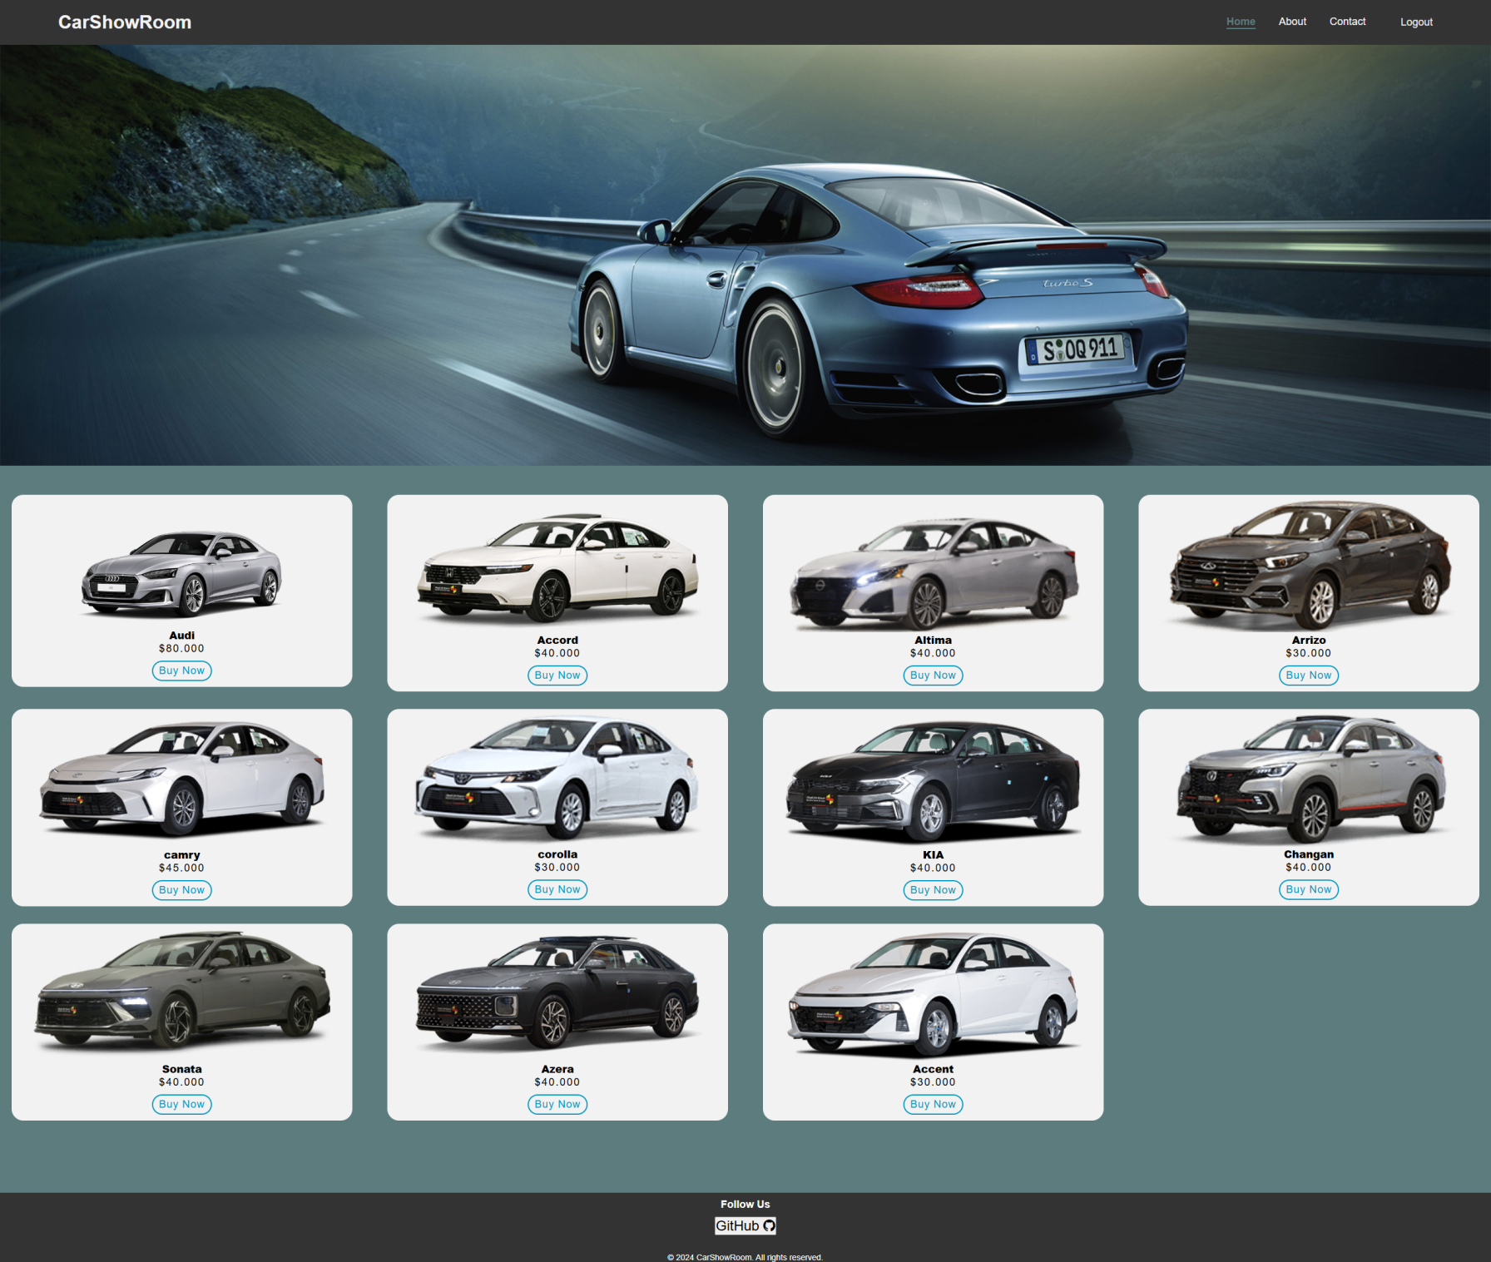
How does our website look?
Home Page
The Home Page displays the products we are offering with their prices.
1
We used containers to separate the cars and their prices form each other.
2
We added a navigation bar so the user can easily access all the pages, as well as a footer with the GitHub page of the website.
3

Slide 7
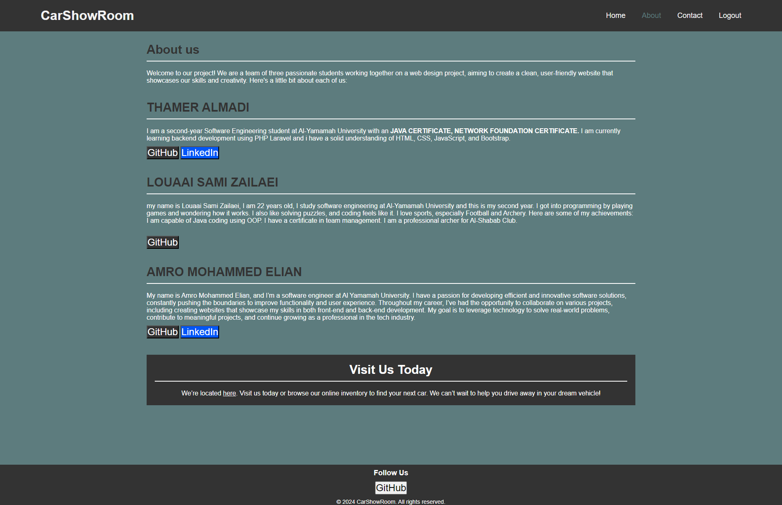
How does our website look?
About Us
This page is a all about our team showing our skills, GitHub links, and LinkedIn Pages.
1
We used sections to divide each part
2
The fonts used in this page are:
font-family: Arial, sans-serif
3

Slide 8
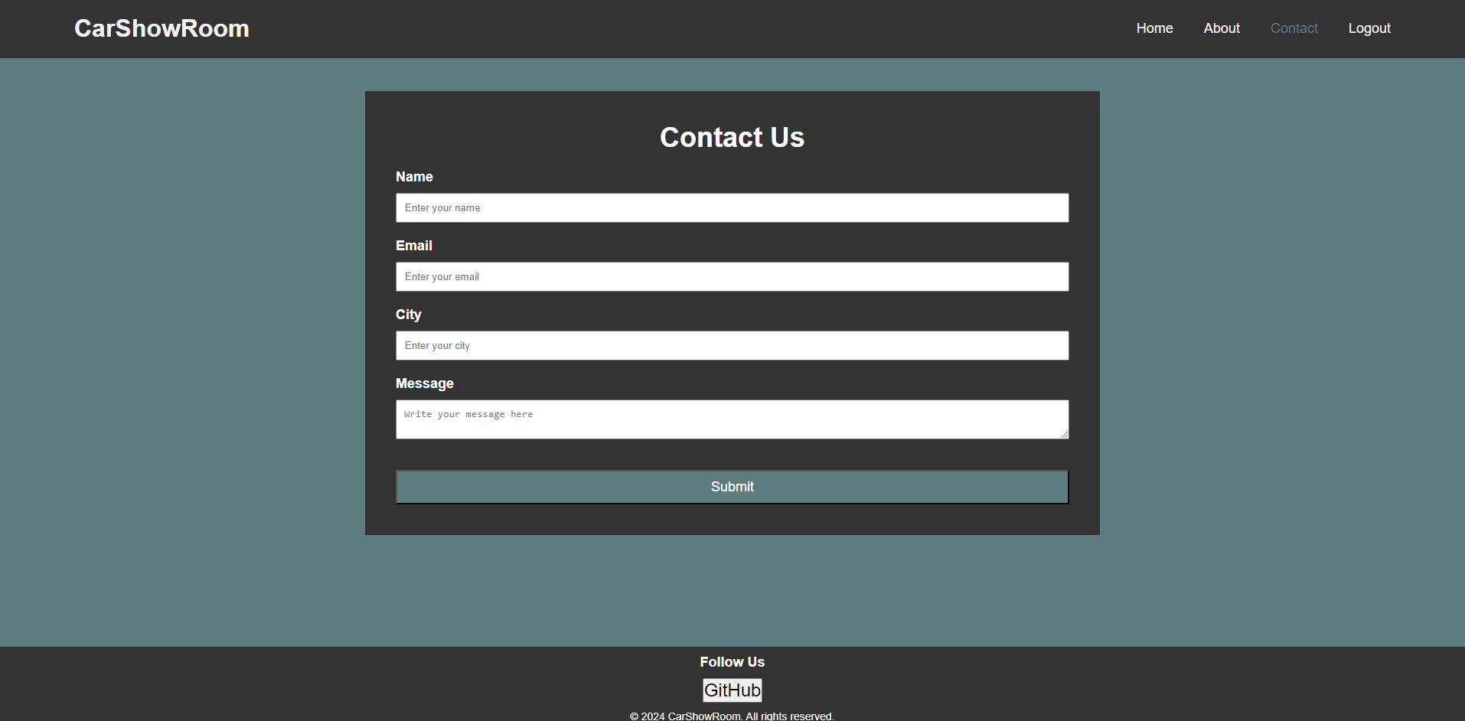
How does our website look?
Contact us
we added a Contact us page as a way of connecting the user with our team by asking, giving comments, or reporting bugs.
1
We used a container to coordinated the form.
2
We added a navigation bar so the user can easily access all the pages. As well as a footer with the GitHub page of the website.
3

Slide 9
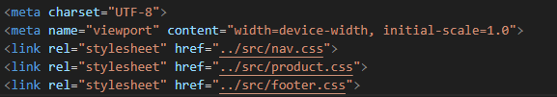



External Links
CSS
BOOSTTRAP
CSS
JAVASCRIPT

Slide 10
CarShowRoom
Thank you for your time! Have a great day!
Louaai Zailaei - 202311058
Thamer Almadi - 202311136
Amro Mohammed Elian - 202311430

